Slide 1
UE18CS390A – Capstone Project Approval
Project Title : Perfect Crop
Project ID : PW22RBA01
Project Guide : Professor Raghu B A
Project Team : Akash, Ishan, Srish, Vishruth

Slide 2
Outline
Problem Statement
Scope and Feasibility study
Applications/Use cases
Expected Deliverables
Capstone (Phase-I & Phase-II) Project Timeline
Any other information

Slide 3
Problem Statement
Our goal in this project is to build a predictive model to recommend the most suitable crop to grow based on the various parameters that describe the soil.

Slide 4
Scope and Feasibility study
Our project has 3 components to it.
(a) Based on existing soil data, building machine learning models that could study the underlying trend in the data and come up with accurate predictions given a soil test instance. On comparing the accuracy of the models, either pick the best one or make use of a combination of these models in order to make the best prediction.

Slide 5
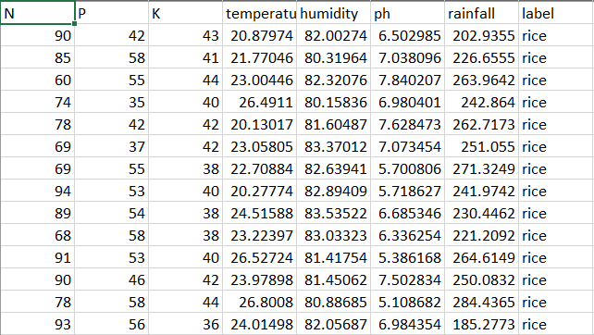
Scope and Feasibility study
A brief view of our dataset
Crops: rice, maize, chick peas, kidney beans, pigeon peas, moth beans, mung bean, black gram, lentil, pomegranate, banana, mango, grapes, watermelon, muskmelon, apple, orange, papaya, coconut, cotton, jute, coffee.

Slide 6
Scope and Feasibility study
(b) Build a device that can extract parameters such as
-> ratio of Nitrogen content in soil.(N)
-> ratio of Phosphorous content in soil.(P)
-> ratio of potassium content in soil.(K)
-> temperature
-> relative humidity %
-> pH value
From a soil sample. (Using Arduino)

Slide 7
Scope and Feasibility study
(c) Build a mobile application which displays results of all the analyses performed in step(a) by passing the parameters of the soil sample as input to the models built in step (a).

Slide 8
Scope and Feasibility study
One major shortcoming of our project is that all the data that is available to us is only with respect to India.
And also, our dataset has classifications for only 22 unique crop species.

Slide 9
Applications/Use cases
Our project comes under the domain of Precision Agriculture. It helps farmers make informed decisions with regards to the kind of crop they must invest in to get good returns. We get to hear a lot of incidents about farmers committing suicide because of poor decision making in crop selection. So our project is a return of favour to all those hard working men and women who slog all day at the fields so that we are able to consume nutritious food.

Slide 10
Expected Deliverables
Capstone phase-I deliverables
Reading up literature surveys that are relevant to the topic of crop prediction using machine learning techniques and summarising all our learnings.
Learn, design and build an Arduino circuit that can read parameters such as N, P, K, temperature, humidity and pH from the soil.

Slide 11
Expected Deliverables
Capstone-II deliverables
Building machine learning models that ingest the existing soil data and come up with accurate predictions. Compare the various models and pick the most accurate one.
Create a mobile application that displays the properties of the soil and the suitable crop that could be grown in it for a give soil sample.

Slide 12
Capstone (Phase-I & Phase-II) Project Timeline
Step 1
Reading literature surveys relevant to our problem statement.
Step 2
A detailed summary of our learnings from the literature survey.
Step 3
Designing an Arduino based circuit that is capable of measuring N, P, K, humidity, temperature and pH from a soil sample.
Step 4
Gathering the required components and building the circuit designed in Step 3.

Slide 13
Capstone (Phase-I & Phase-II) Project Timeline
Step 5
Coding for the complete working of the circuit. Extracting and formatting the values output by the circuit.
Step 6
Building machine learning models for the data at hand.
Step 7
Comparing the accuracies of the models built in the previous step and picking either the most accurate one or combining 2 or more models to achieve higher accuracy.
Step 8
Building a mobile application to display the results for a given soil sample.

Slide 14
Thank You

